Slide 1
What’s a protocol?
Network protocols:
All communication in Internet governed by protocols
Generic protocol:
  specific messages sent
  specific actions taken when messages are received, or other events (e.g., timer expiration, exception detection)
Protocol Representation:
  Finite State Machines
  Protocol Specification, via Standards …
protocols define format, order of messages sent and received among network entities, and actions taken on message transmission, receipt

Slide 2


















Network structure:
Network edge: applications and hosts
mobile network
global ISP
Access networks, physical media: wired, wireless communication links
home
network
regional ISP
Network core:
  interconnected routers
  network of networks
institutional
network

Slide 3

The network edge:
End systems (hosts):
  run application programs
  e.g. Web, email
  at “edge of network”
peer-peer
Client-server model
  client host requests, receives service from always-on server
  e.g. Web browser/server; email client/server
client/server
Peer-to-peer model:
  minimal (or no) use of dedicated servers
  e.g. Skype, BitTorrenth

Slide 4

Host: sends packets of data
host sending function:
takes application message
breaks into smaller chunks, known as packets, of length L bits
transmits packet into access network at transmission rate R
  link transmission rate, aka link capacity, aka link bandwidth
two packets,
L bits each
2
1
R: link transmission rate
host
packet
transmission
delay
time needed to
transmit L-bit
packet into link
L (bits)
R (bits/sec)
=
=

Slide 5
Internet Structure: loose hierarchy
hierarchy based on administrative regions/providers

Slide 6
Internet structure: network of networks
End systems connect to Internet via access ISPs (Internet Service Providers)
  residential, company and university ISPs
Access ISPs in turn must be interconnected.
  so that any two hosts can send packets to each other
Resulting network of networks is very complex
  evolution was driven by economics and national policies

Slide 7
Internet structure: network of networks
Question: given millions of access ISPs, how to connect them together?
…
…
access
net
access
net
access
net
access
net
access
net
access
net
access
net
…
…
access
net
access
net
access
net
access
net
access
net
access
net
…
access
net
access
net
…
access
net

Slide 8
Internet structure: network of networks
Option: connect each access ISP to every other access ISP?
…
…
access
net
access
net
access
net
access
net
access
net
…
…
access
net
access
net
…
connecting each access ISP to each other directly doesn’t scale: O(N²) connections.
…
…
access
net
access
net
…
access
net
access
net
access
net
…
access
net
…
access
net
access
net
…
access
net

Slide 9
Internet structure: network of networks
Option: connect each access ISP to one global transit ISP?
Customer and provider ISPs have economic agreement.
…
…
access
net
access
net
access
net
access
net
access
net
access
net
access
net
…
…
global
ISP
access
net
access
net
access
net
access
net
access
net
access
net
…
access
net
access
net
…
access
net

Slide 10
Internet structure: network of networks
But if one global ISP is viable business, there will be competitors ….
…
…
access
net
access
net
access
net
access
net
access
net
access
net
ISP A
access
net
…
…
access
net
ISP B
access
net
ISP C
access
net
access
net
access
net
access
net
…
access
net
access
net
…
access
net

Slide 11
Internet structure: network of networks
But if one global ISP is viable business, there will be competitors …. which must be interconnected
Internet exchange point
…
…
access
net
access
net
access
net
access
net
access
net
IXP
access
net
access
net
ISP A
…
…
access
net
IXP
ISP B
access
net
ISP C
access
net
access
net
peering link
access
net
access
net
…
access
net
access
net
…
access
net

Slide 12
Internet structure: network of networks
… and regional networks may arise to connect access nets to ISPs
…
…
access
net
access
net
access
net
access
net
access
net
IXP
access
net
access
net
ISP A
…
…
access
net
IXP
ISP B
access
net
ISP C
access
net
access
net
access
net
regional net
access
net
…
access
net
access
net
…
access
net

Slide 13
Internet structure: network of networks
… and content provider networks (e.g., Google, Microsoft, Akamai) may run their own network, to bring services, content close to end users
…
…
access
net
access
net
access
net
access
net
access
net
IXP
access
net
access
net
ISP A
…
…
Content provider network
access
net
IXP
ISP B
access
net
ISP C
access
net
access
net
access
net
regional net
access
net
…
access
net
access
net
…
access
net

Slide 14
Internet structure: network of networks
Tier 1 ISP
Tier 1 ISP
Google
IXP
IXP
IXP
Regional ISP
Regional ISP
access
ISP
access
ISP
access
ISP
access
ISP
access
ISP
access
ISP
access
ISP
access
ISP
at center: small # of well-connected large networks
  “tier-1” commercial ISPs (e.g., Level 3, Sprint, AT&T, NTT), national & international coverage
  content provider network (e.g., Google): private network that connects its data centers to Internet, often bypassing tier-1, regional ISPs

Slide 15
Tier-1 ISP: e.g., Sprint
POP: point-of-presence
to/from backbone
peering
…
…
…
…
…
to/from customers

Slide 16
Internet structure: network of networks
a packet passes through many networks down and up the hierarchy!
local
ISP
Tier 3
ISP
local
ISP
local
ISP
local
ISP
Tier-2 ISP
Tier-2 ISP
Tier 1 ISP
Tier 1 ISP
Tier 1 ISP
Tier-2 ISP
Tier-2 ISP
Tier-2 ISP
local
ISP
local
ISP
local
ISP
local
ISP

Slide 17
Internet Hierarchy
hierarchy based on routing (more later)

Slide 18
Hierarchical Architecture (+s, -s)
Advantages
  Isolates and scopes internal dynamics: dampens oscillations, providing stability to the overall network
  Supports scalability: aggregation/summary per domain for smaller, more efficient routing tables
  Allows for flexibility: domains deploy different protocols, policies …
Disadvantages
  Overhead of establishing and maintaining the hierarchy (esp. for mobile, dynamic nets)
  Sub-optimality of routing …

Slide 19
Why layering?
Dealing with complex systems:
explicit structure allows identification, relationship of complex system’s pieces
  layered reference model for discussion
modularization eases maintenance, updating of system
  change of implementation of layer’s service transparent to rest of system
  change in one layer doesn’t affect rest of system
  (is this true?!)
Can layering be considered harmful?

Slide 20
Internet protocol stack
application: supporting network applications
  FTP, SMTP, HTTP
transport: process-process data transfer
  TCP, UDP
network: routing of datagrams from source to destination
  IP, routing protocols
link: data transfer between neighboring network elements
  892.11 (WiFi), Ethernet, PPP
physical: bits “on the wire”
application
transport
network
link
physical

Slide 21

Encapsulation
source
message
M
application
transport
network
link
physical
segment
H_{t}
M
H_{t}
datagram
H_{n}
H_{n}
H_{t}
M
frame
H_{l}
H_{n}
H_{t}
M
link
physical
switch
destination
H_{n}
H_{t}
M
network
link
physical
M
application
transport
network
link
physical
H_{l}
H_{n}
H_{t}
M
H_{n}
H_{t}
M
H_{t}
M
H_{n}
H_{t}
M
H_{l}
H_{n}
H_{t}
M
router

Slide 22
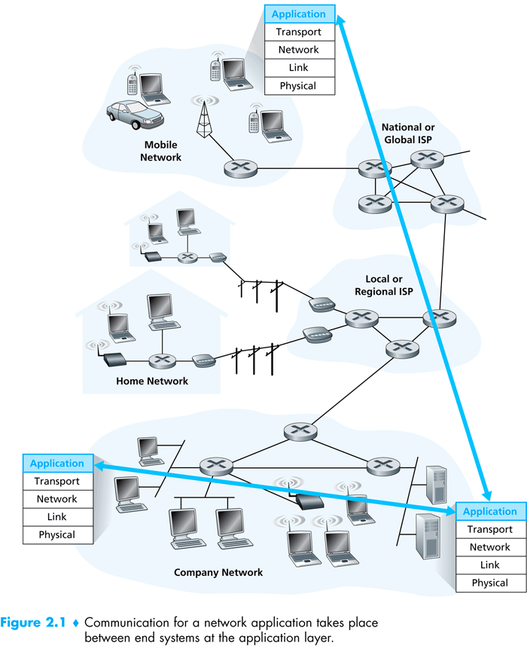

Slide 23
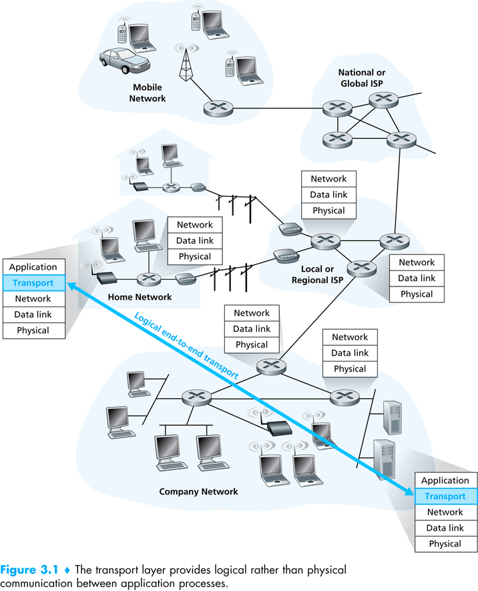

Slide 24
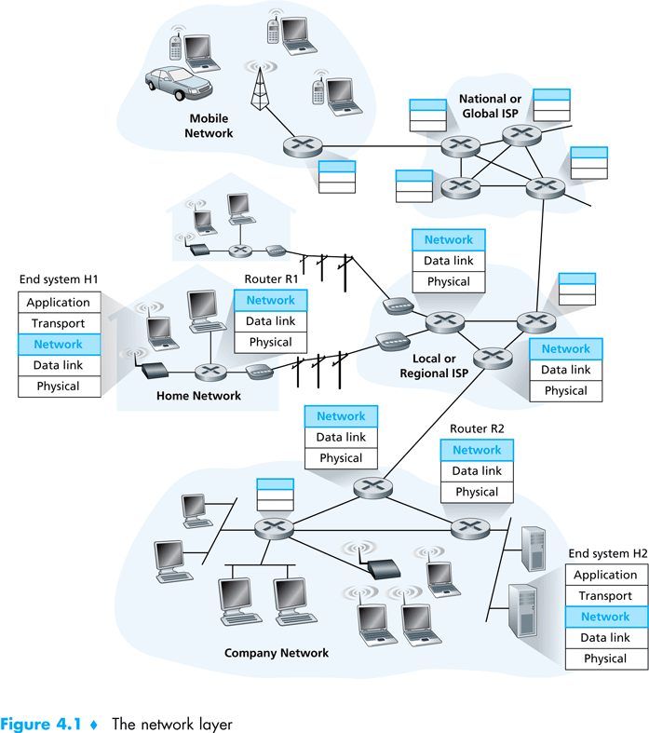

Slide 25
Layering & protocol stacks:
(the protocol hour-glass – thin waist)

Slide 26
Network Core: Circuit Switching
End-to-end resources reserved for “call”
link bandwidth, switch capacity
dedicated resources: no sharing
circuit-like (guaranteed) performance
call setup required
re-establish call upon failure

Slide 27
Network Core: Circuit Switching
network resources (e.g., bandwidth) divided into “pieces”
pieces allocated to calls
resource piece idle if not used by owning call (no sharing)
MULTIPLEXING: dividing link bandwidth into “pieces”
  frequency division
  time division
Multiplexing is so fundamental and influences many aspects of the technology, including congestion, buffering, delays, routing, …

Slide 28
Circuit Switching: FDM and TDM
Example:
FDM
4 users
frequency
time
TDM
frequency
time
Notes:
Two simple multiple access control techniques.
Each mobile’s share of the bandwidth is divided into portions for the uplink and the downlink. Also, possibly, out of band signaling.
As we will see, used in AMPS, GSM, IS-54/136

Slide 29
Internet Design Goals/Principles
Scalability & economic access:
  Resource sharing, reduce reservations, allow for higher utilization
  Use of packet switching (statistical multiplexing) instead of circuit switching
Robustness:
  Re-routing around failures
  Stateless connections, dynamic routing
Reliablility:
  Timed retransmission, based on acks, seq. #s
Evolvablility:
  Minimize complexity in the network and push functionality to the edges (end-to-end principles)
* to revisit during history discussions later

Slide 30
Network Core: Packet Switching
each end-end data stream divided into packets
user A, B packets share network resources
each packet uses full link bandwidth
resources used as needed
resource contention:
aggregate resource demand can exceed amount available
congestion: packets queue, wait for link use
store and forward: packets move one hop at a time
  Node receives complete packet before forwarding
Bandwidth division into “pieces”
Dedicated allocation
Resource reservation

Slide 31
Packet Switching: Statistical Multiplexing
100 Mb/s
Ethernet
A
C
statistical multiplexing
1.5 Mb/s
B
queue of packets
waiting for output
link
D
E
Sequence of A & B packets does not have fixed pattern, bandwidth shared on demand ➔ statistical multiplexing.
TDM: each host gets same slot in revolving TDM frame.

Slide 32
Packet Switching: queueing delay, loss
R = 100 Mb/s
C
A
D
R = 1.5 Mb/s
B
E
queue of packets
waiting for output link
queuing and loss:
if arrival rate (in bits) to link exceeds transmission rate of link for a period of time:
  packets will queue, wait to be transmitted on link
  packets can be dropped (lost) if memory (buffer) fills up

Slide 33



Packet-switching: store-and-forward
L bits
per packet
source
3
2
1
R bps
R bps
destination
takes L/R seconds to transmit (push out) L-bit packet into link at R bps
store and forward: entire packet must arrive at router before it can be transmitted on next link
one-hop numerical example:
L = 7.5 Mbits
R = 1.5 Mbps
one-hop transmission delay = 5 sec
end-end delay = 2L/R (assuming zero propagation delay)
more on delay shortly …

Slide 34
Packet switching versus circuit switching
Packet switching allows more users to use network!
1 Mb/s link
each user:
  100 kb/s when “active”
  active 10% of time
circuit-switching:
  10 users
packet switching:
  with 35 users, probability > 10 active at same time is less than .0004
N
users
…..
1 Mbps link
Q: how did we get value 0.0004?
Use binomial distribution …
Q: what if > 35 users share the link?
Conduct statistical analysis

Slide 35
Two key network-core functions
routing: determines source-destination route taken by packets
  routing algorithms
  (more later!)
forwarding: move packets from router’s input to appropriate router output
routing algorithm
local forwarding table
header value
output link
0100
0101
0111
1001
3
2
2
1
1
3
2
0111
destination address in arriving
packet’s header

Slide 36
Packet switching vs. Circuit switching
Is packet switching a “slam dunk winner?” There’s a “trade-off”
great for bursty data
  resource sharing (scalable!)
  simpler, no call setup, more robust (re-routing)
excessive congestion: packet delay and loss
  Without admission control: protocols needed for reliable data transfer, congestion control
Q: How to provide circuit-like behavior?
  bandwidth guarantees needed for audio/video apps
  still an unsolved problem (chapter 7), virtual circuit

Slide 37
How do loss and delay occur?
packets queue in router buffers
packet arrival rate to link (temporarily) exceeds output link capacity
packets queue, wait for turn
packet being transmitted (delay)
A
B
packets queueing (delay)
free (available) buffers: arriving packets
dropped (loss) if no free buffers

Slide 38
Four sources of packet delay
transmission
A
propagation
B
nodal
processing
queueing
d_{nodal} = d_{proc} + d_{queue} + d_{trans} + d_{prop}
d_{trans}: transmission delay:
L: packet length (bits)
R: link bandwidth (bps)
d_{trans} = L/R
d_{prop}: propagation delay:
d: length of physical link
s: propagation speed (~2x10⁸ m/sec)
d_{prop} = d/s
d_{trans} and d_{prop}
very different
* Check out the online interactive exercises for more examples: http://gaia.cs.umass.edu/kurose_ross/interactive/
* Check out the Java applet for an interactive animation on trans vs. prop delay
Notes:
38

Slide 39



Queueing delay (revisited)
R: link bandwidth (bps)
L: packet length (bits)
a: average packet arrival rate
average queueing delay
traffic intensity
= La/R
La/R ~ 0: avg. queueing delay small
La/R -> 1: avg. queueing delay large
La/R > 1: more “work” arriving
than can be serviced, average delay infinite!
La/R ~ 0
La/R -> 1
* Check online interactive animation on queuing and loss

Slide 40
Packet loss
queue (buffer) preceding link in buffer has finite capacity
packet arriving to full queue dropped (lost)
lost packet may be retransmitted by previous node, by source end system, or not at all
buffer
(waiting area)
A
packet being transmitted
B
packet arriving to
full buffer is lost
* Check out the Java applet for an interactive animation on queuing and loss

Slide 41
Throughput
R_{s} < R_{c} What is average end-end throughput?
R_{s} bits/sec
R_{c} bits/sec
R_{s} > R_{c} What is average end-end throughput?
R_{s} bits/sec
R_{c} bits/sec
bottleneck link
link on end-end path that constrains end-end throughput

Slide 42
Throughput: Internet scenario
per-connection end-end throughput: min(R_{c},R_{s},R/10)
in practice: R_{c} or R_{s} is often bottleneck
R_{s}
R_{s}
R_{s}
R
R_{c}
R_{c}
R_{c}
10 connections (fairly) share backbone bottleneck link R bits/sec
* Check out the online interactive exercises for more examples: http://gaia.cs.umass.edu/kurose_ross/interactive/

Slide 43
Bad guys: attack server, network infrastructure
Denial of Service (DoS): attackers make resources (server, bandwidth) unavailable to legitimate traffic by overwhelming resource with bogus traffic
1. select target
2. break into hosts around the network (see botnet)
3. send packets to target from compromised hosts
target

Slide 44
Bad guys can sniff packets
packet “sniffing”:
  broadcast media (shared Ethernet, wireless)
  promiscuous network interface reads/records all packets (e.g., including passwords!) passing by
A
C
src:B dest:A payload
B
  wireshark software used for end-of-chapter labs is a (free) packet-sniffer

Slide 45


application
(www browser,
email client)
packet
analyzer
application
OS
packet
capture
(pcap)
Transport (TCP/UDP)
Network (IP)
Link (Ethernet)
Physical
copy of all Ethernet frames sent/received

Slide 46
Bad guys can use fake addresses
IP spoofing: send packet with false source address
A
C
src:B dest:A payload
B
… lots more on security (throughout, Chapter 8)

